Slide 1



Portsmouth Square
Restroom Improvements
Community Meeting #1
December 8, 2011

Slide 2


Welcome
欢迎

Slide 3
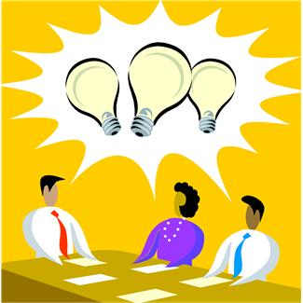
Agenda
Welcome & Introductions
Ground Rules
Purpose of Meeting
Project Background
Planning Process & Schedule
Program Requirements
Issues, Opportunities & Constraints
Massing Studies
Public Comments
Next Steps

Slide 4


Ground Rules
Keep to the agenda
Turn off cell phones & pagers
Disruptions will NOT be tolerated
Raise your hand to speak
Direct comments to the facilitator
Working together will make this a productive meeting!

Slide 5

Purpose of Meeting
To provide an opportunity for public input on the future improvements planned for restroom facilities at Portsmouth Square.
(Please direct facility maintenance questions to Marianne Bertuccelli at (415) 695-5004 or Marianne.Bertuccelli@sfgov.org. Thank you.)

Slide 6

Project Background
2008 “Clean and Safe” Park Bond
Restroom Program
$11.4 million
21 existing sites
New restrooms
Project Team
Marvin Yee, Project Manager, RecPark
Melissa Hung, Assistance PM, RecPark
Marianne Bertuccelli, Area Manager, RecPark
Tony Leung, Architect, DPW

Slide 7

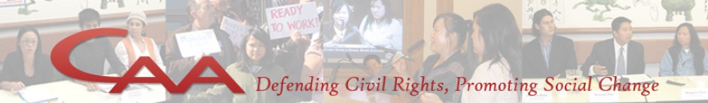

Project Background
Preliminary Planning
Site Analysis
RPD Staff
Neighborhood Organizations
Chinatown CDC
Self-Help for the Elderly
Portsmouth Square Garage
Chinese for Affirmative Action

Slide 8

Planning Process & Schedule
Community Meetings (Dec 2011 – Feb 2012)
Meeting #1 – Introduction and Public Input
Meeting #2 – Draft Plan and Public Input
Meeting #3 – Final Conceptual Plan
Commission Approval (Mar 2012)
Construction Documents (Apr – Sept 2012)
Bid and Award (Oct 2012 – Jan 2013)
Construction (Feb – July 2013)
Completion – Grand Opening !!!

Slide 9
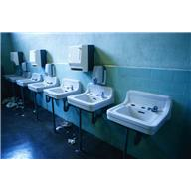
Program Requirements
Increase capacity
Preserve performance space
Consider pedestrian circulation
Maintain storage
Avoid hidden spaces

Slide 10
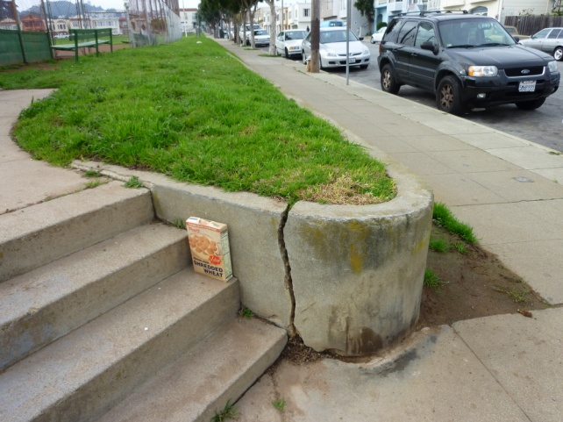
Issues, Opportunities & Constraints
LANDSCAPE/OUTDOOR SPACES
Recreational Uses
Old Infrastructure
irrigation system
poor lighting
unhealthy landscape
damaged hardscape
Playground Safety Guidelines
Americans with Disabilities Act
Undefined and Poorly Located Entrances

Slide 11
The Building

Slide 12
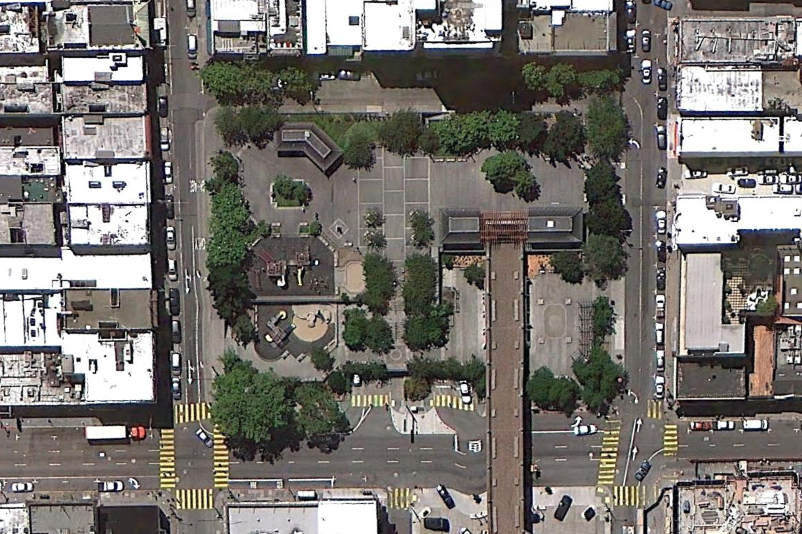
AERIAL VIEW
RESTROOM LOCATION

Slide 13
ISSUES, CONSTRAINTS, & OPPORTUNITIES
1. EXISTING ISSUES
2. CONSTRAINTS
3. OPPORTUNITIES
Current restroom capacity does not meet demand
Restroom layout currently does not comply with ADA
Exposed garbage bins create an unwelcoming plaza entry
The existing concrete structure is damaged and in need of repair
The current restroom layout allows for direct sightlines into the restrooms
Confined janitor storage space
Plumbing lines leak to the garage below
Existing concrete building structure is inflexible and difficult to modify
The unique existing design
Matching the existing materials
The preservation of the performance space
The existing plaza/ garage concrete deck construction
Add capacity to the existing restrooms: minimum 5 stalls for women, 3 urinals & 2 stalls for men
New design that complies with current accessibility and building codes
Add storage capacity to the janitor’s storage room
Build a new and highly functional restroom building that serves the park’s users
Use materials that are easy to maintain and clean
Improve the plaza entry area with new landscaping.

Slide 14
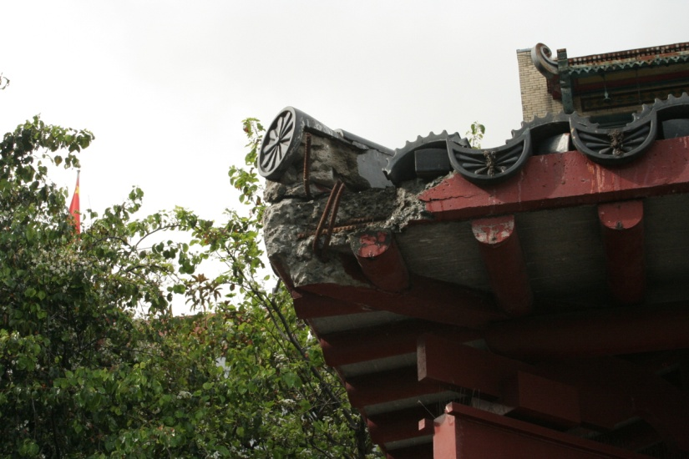
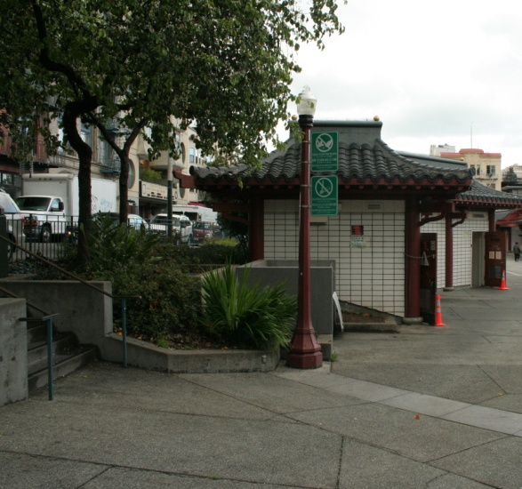
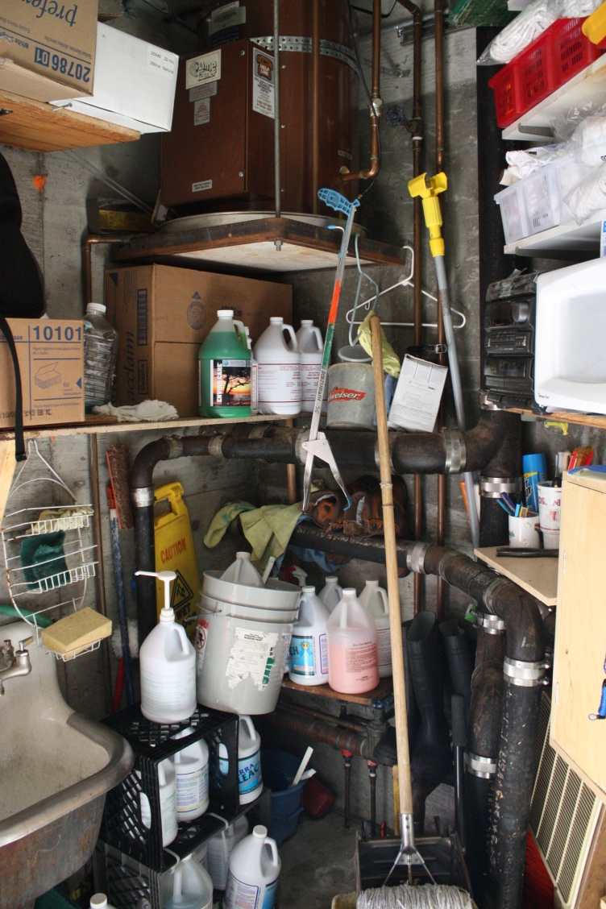
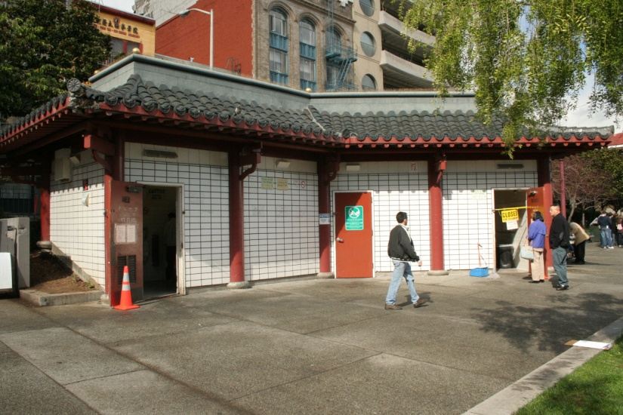
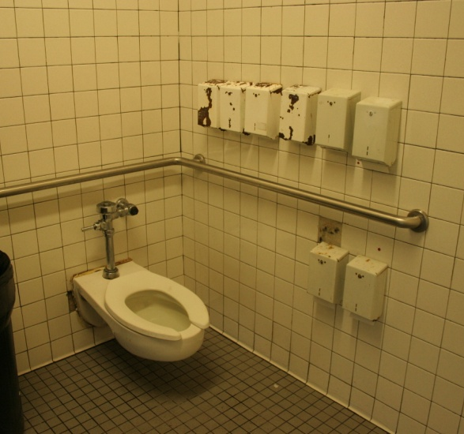
EXISTING CONDITIONS
DAMAGED EXTERIOR CONCRETE STRUCTURE
EXPOSED GARBAGE BINS
INSUFFICIENT STORAGE ROOM
SIGHTLINES INTO THE OPEN RESTROOMS
INSUFFICIENT RESTROOM STALLS TO HANDLE DEMAND

Slide 15
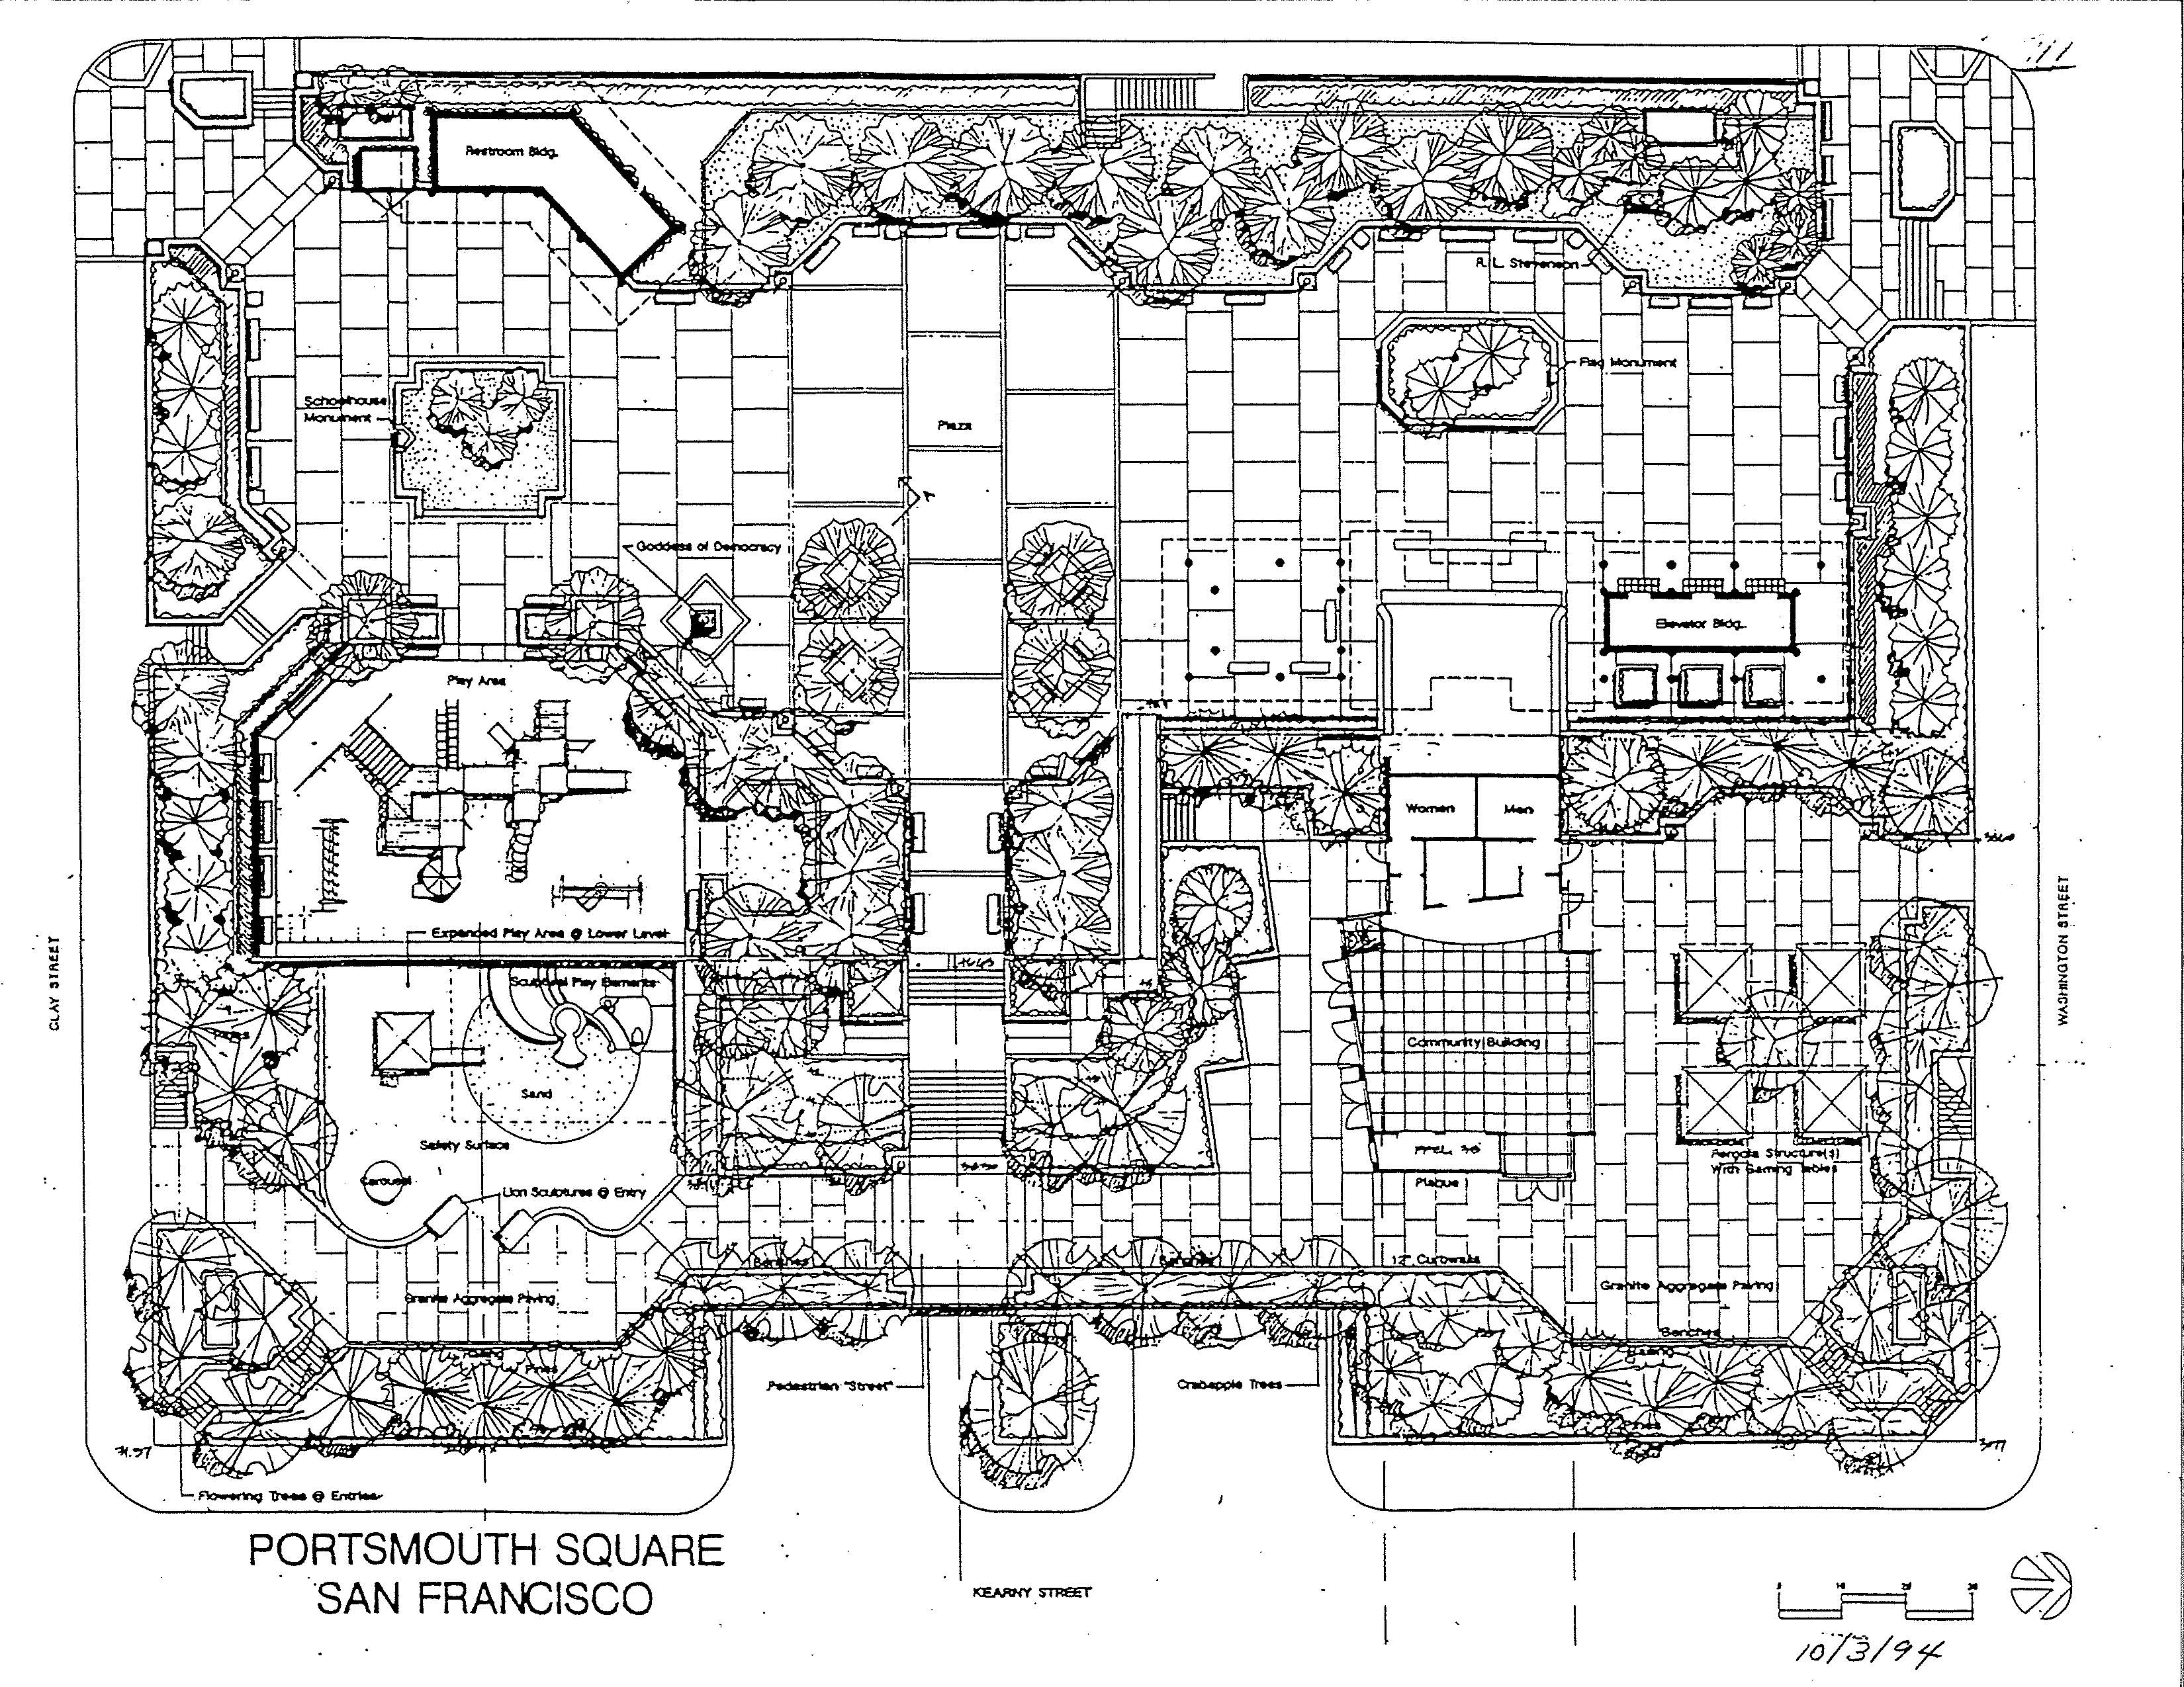
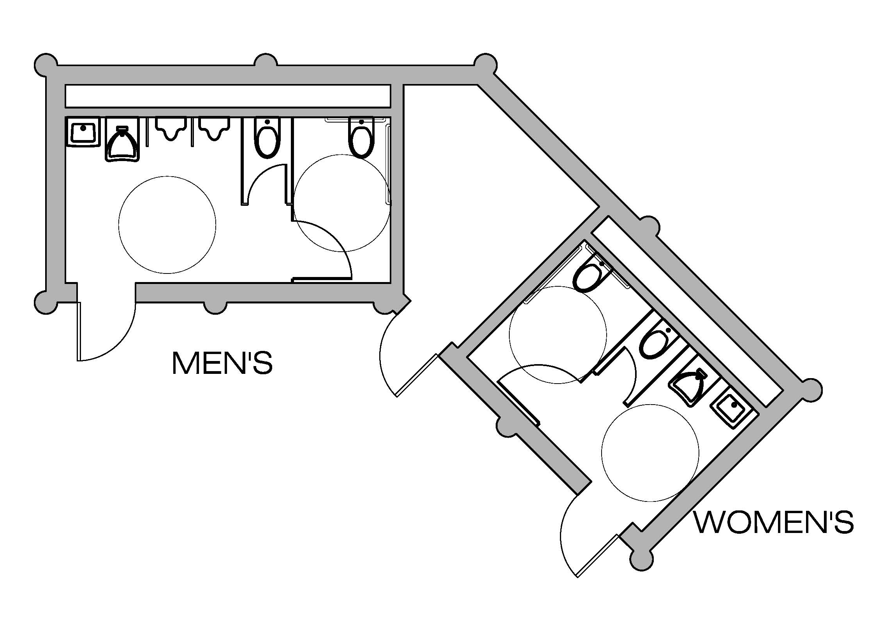
EXISTING FLOOR PLAN
LOCATION OF EXISTING RESTROOM
JANITOR STORAGE
Existing Building Layout

Slide 16
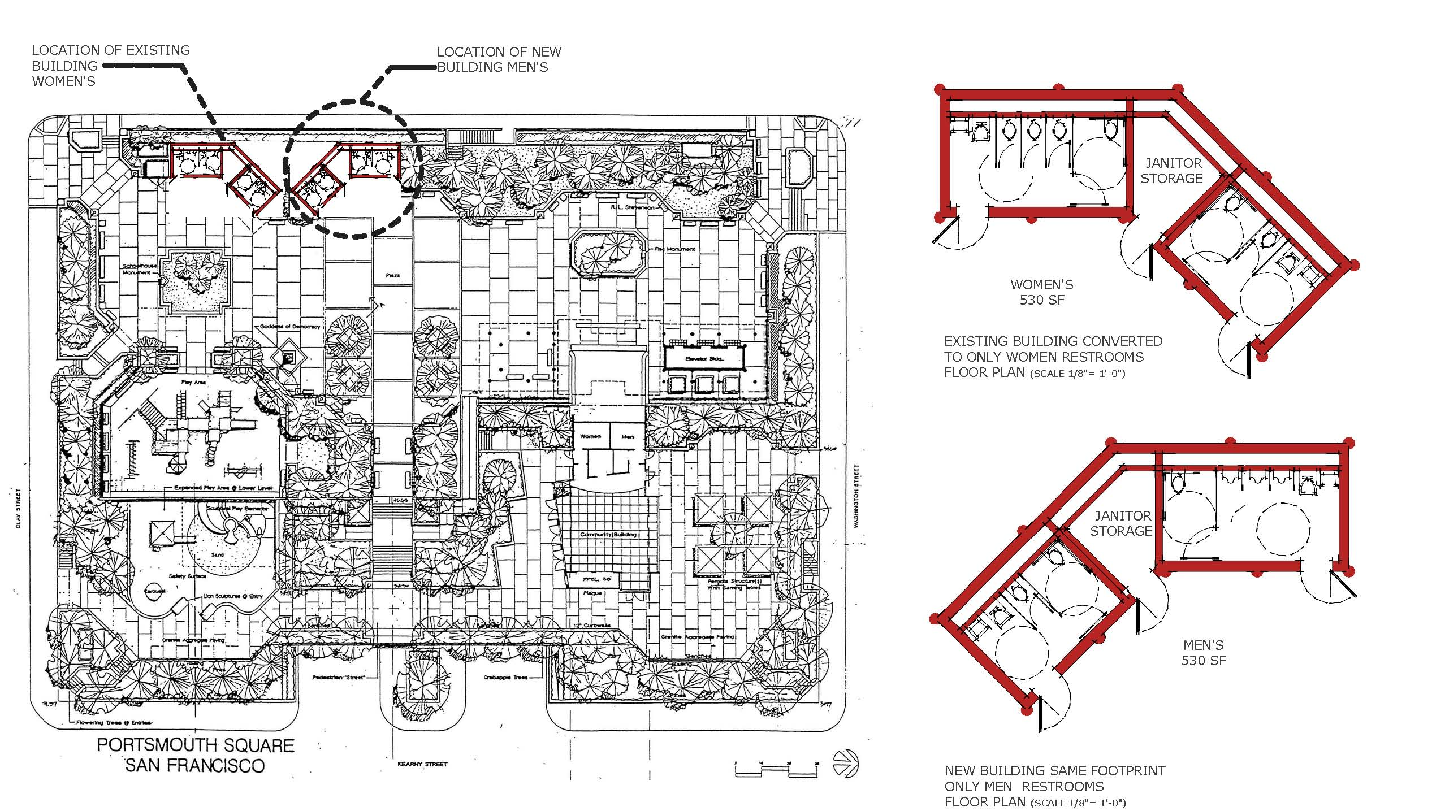
CONCEPT 1: Mirror the existing building
LOCATION OF PROPOSED BUILDING
Pros:
Add capacity to restrooms & janitor’s storage room
Separate buildings for men & women
Two distinct women’s restrooms allows for temporary shutdown for cleaning
Preserve the existing building and mirror its original concept
Cons:
Difficult to match original materials
Disrupts informal staging area
Loading of new building needs to be evaluated

Slide 17
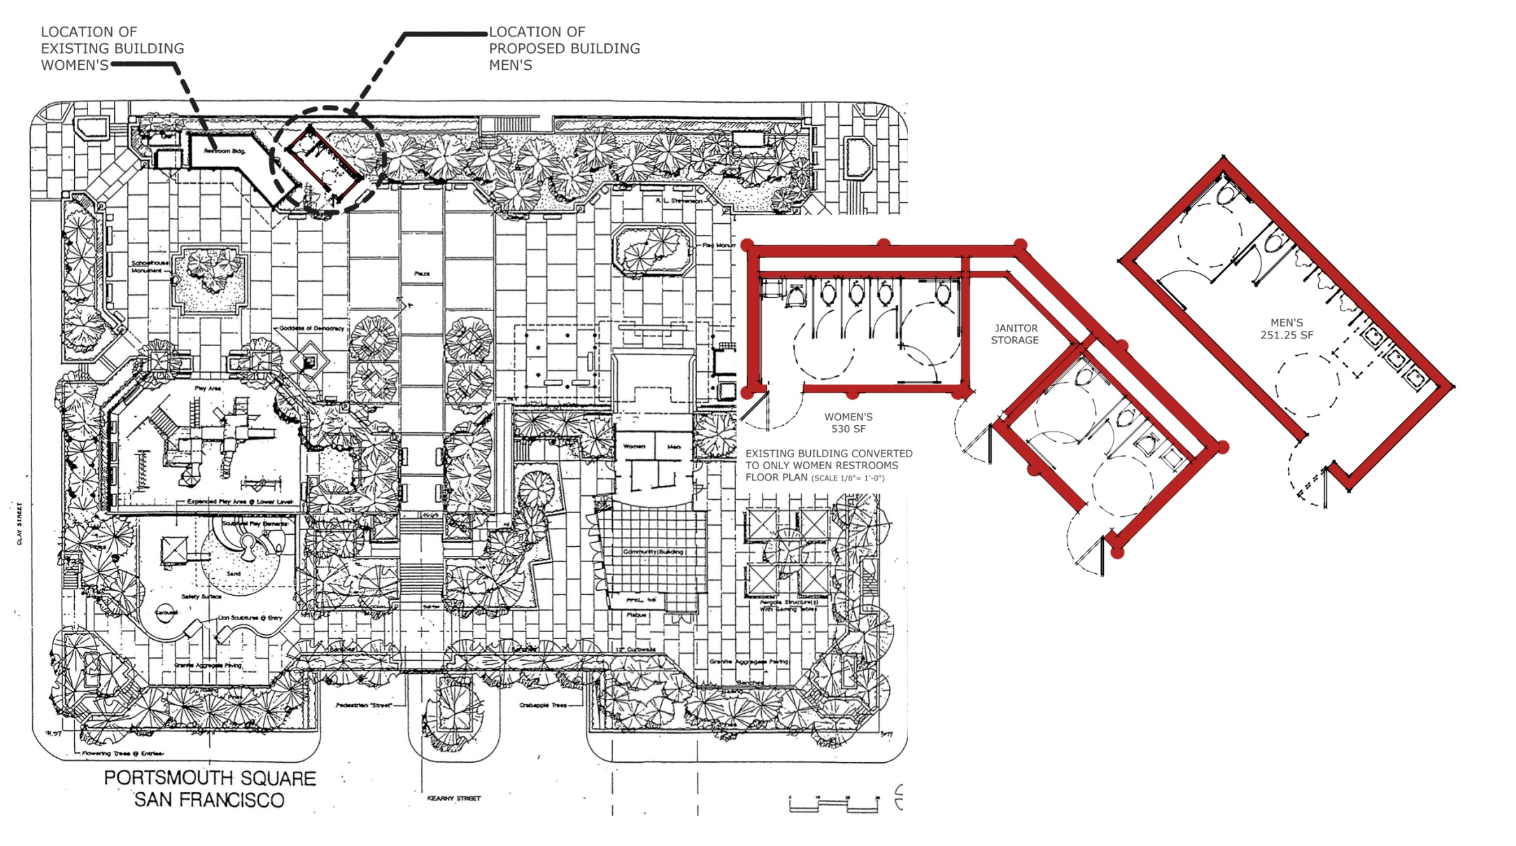
CONCEPT 2: New men’s restroom addition
NEW BUILDING ADDITION
Pros:
Add capacity to restrooms & janitor’s storage room
Separate buildings for men & women
Two distinct women’s restrooms allows for temporary shutdown for cleaning
Preserve the existing building and its original concept
New addition does not infringe into informal staging area
Cons:
Proximity to existing building and roof overhang
Loading of new building needs to be evaluated

Slide 18
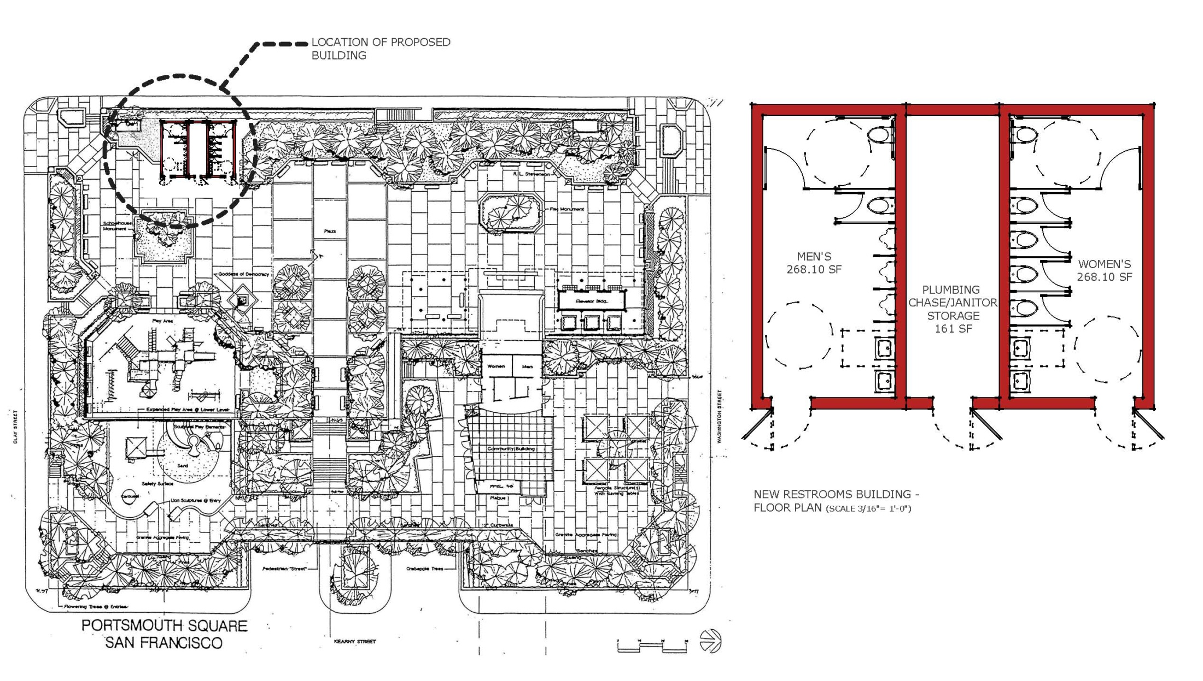
CONCEPT 3: New restroom building
Pros:
Build a bigger and more flexible restroom building & janitor storage room
Build a new and highly functional restroom building
Selection of highly durable materials
Improve the plaza entry area with new landscaping
Preserve the informal performance space
Cons:
Difficult to match original materials
Less integration into the existing park design and concept.

Slide 19
Public Comments
Likes/Dislikes with the Current Restroom?
Feedback on Options Presented
Use Patterns
Unique Site Conditions
Other Considerations

Slide 20
Contact Information
Please submit additional comments to:
Marvin Yee, Project Manager
Recreation and Park Department
30 Van Ness Ave, 5th Floor
S.F., CA 94102
Phone: (415) 581-2541
Fax: (415) 581-2540
E-Mail: Marvin.Yee@sfgov.org
Website: www.parks.sfgov.org

Slide 21
Thank you!
谢谢 !

