Slide 1



Portsmouth Square
Restroom Replacement
Community Meeting #5
January 8, 2013

Slide 2


Welcome
欢迎

Slide 3

Agenda
Welcome
Ground Rules
Purpose of Meeting
Project Background
Project History
Planning Process & Schedule
Basis for Revisions
Program Requirements
Design Revisions Presentation
Public Comments & Discussions
Next Steps

Slide 4


Ground Rules
Keep to the agenda
Turn off cell phones & pagers
Disruptions will NOT be tolerated
Raise your hand to speak
Direct comments to the facilitator
Working together will make this a productive meeting!

Slide 5
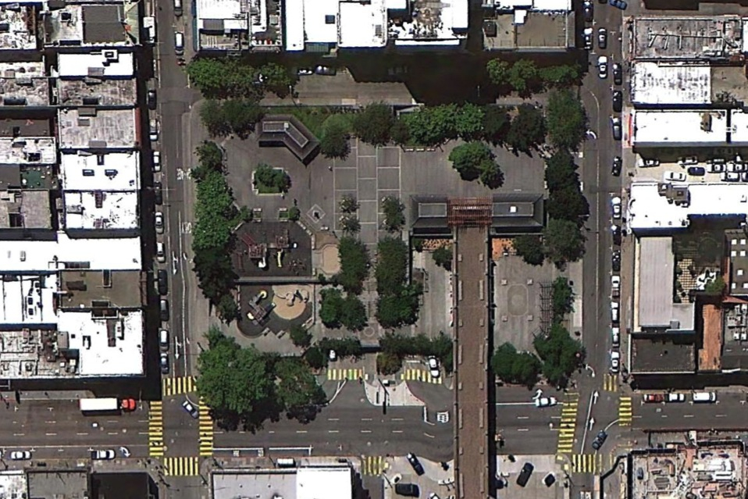
AERIAL VIEW
RESTROOM LOCATION

Slide 6

Purpose of Meeting
To provide a project update; and to solicit feedback on design revisions for a new restroom facility at Portsmouth Square.
(Please direct facility maintenance questions to Carol Sionkowski at Carol.Sionkowski@sfgov.org. Thank you.)

Slide 7

Project Background
2008 “Clean and Safe” Park Bond
  Restroom Program
  $11.4 million
  21 existing sites
  Renovate, replace and new
  $650,000 construction for Portsmouth Sq.
Project Team (Marvin Yee, Project Manager)
  Recreation and Park Dept.
  Chinatown CDC
  Hamilton+Aitken Architects

Slide 8



Project History
Preliminary Planning
  Site Analysis
  RPD Staff
  Neighborhood Organizations
    Chinatown CDC
    Self-Help for the Elderly
    Portsmouth Square Garage
    Chinese for Affirmative Action
Community Meetings

Slide 9

Planning Process & Schedule
Community Meetings
  Meeting #1 – Introduction and Public Input
  Meeting #2 (8/30/12) – Massing Studies and Design Ideas
  Meeting #3 (9/20/12) – Plan and Design Alternatives
  Meeting #4 (10/4/12) – Final Plan and Design
  Meeting #5 (1/8/13) – Update and Design Revisions
RecPark Commission Approval (Oct 2012)
Arts Commission Approval
  Phase 1 Review (10/15/12 & 12/17/12) – Initial Concept
  Phase 2 Review (1/14/13) – Finalize Concept and Materials
  Phase 3 Review (2/18/13) – Construction Documents
Bid and Award (Mar – Jun 2013)
Construction (Aug – Dec 2013)
Completion – Grand Opening !!!

Slide 10

Basis for Revisions
Arts Commission Review
  Roofed pavilion as basic structure
  Blur the edges of indoor/outdoor spaces
  Create outdoor seating
  Study a shed-roof option
Construction budget of $650K
  Previous design estimated at $900K
  More efficient building footprint
  Increased men’s room capacity

Slide 11
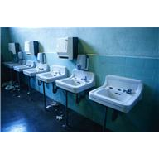
Program Requirements
Increase capacity
Ensure user privacy
Maintain storage
Preserve performance space
Consider pedestrian circulation
Avoid hidden spaces

Slide 12
INSERT H+A SLIDES

Slide 13

Thank you!
谢谢 !

